Slide 1
Prince William Sound Underwater Profiling Vehicle
The Aquanauts
Jason Lee, Jim O’Donnell, Ruben Quiros, Shayna Seidel, Shelby Crisp, and Timothy Pierce

Slide 2
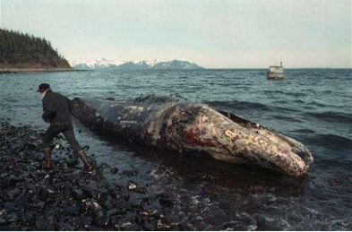
Background: Prince William Sound
In 1989 the Exxon Valdez oil tanker crashed into Bligh Reef, spilling 10.8 million gallons of oil in PWS
Many species and industries were affected by this disaster
There has been improvement over the years, but PWS is still in recovery

Slide 3
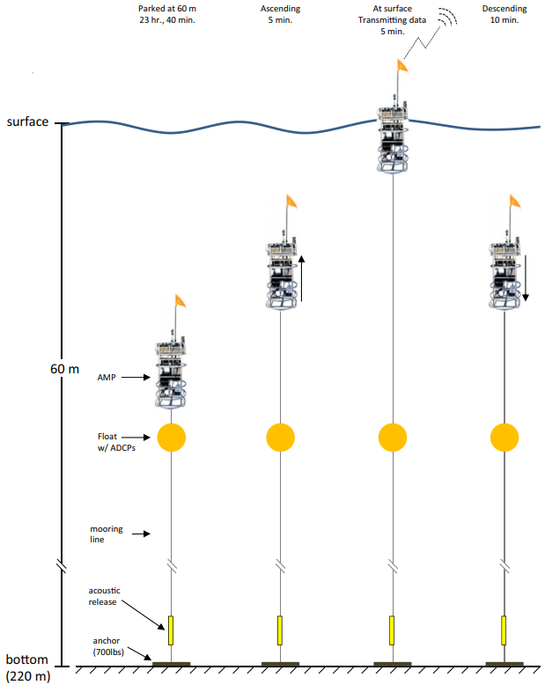
Background: Profiler
Since 2013 Ocean scientists have used an autonomous moored profiler (AMP) to collect environmental data on the recovery of PWS
The profiler has an anchor that holds it at a specified depth
The profiler ascends to the surface once a day to collect data and transmit a signal that it is still alive

Slide 4

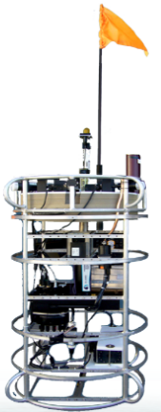
Problems
Only 1/10th of data is currently being transferred remotely
Someone must travel to the platform every few weeks in order to extract data
This trip can be difficult and dangerous
The data processing components are outdated
The profiler does not have the flexibility to turn on/off individual sensors (save battery life)

Slide 5
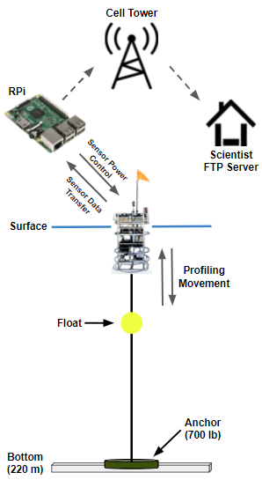
Our Solution
Update the microcontroller to accommodate modern cellular capabilities and data storage
Raspberry Pi 3B running Raspbian (Lightweight Debian Linux)
Transmit 100% of data to ocean scientists via FTP over a cellular connection
Not considering plankton camera
Custom PCB to power microcontroller & enable sensors on a schedule from the profiler’s on-board battery
Signal to enable or disable sensor from Raspberry Pi

Slide 6
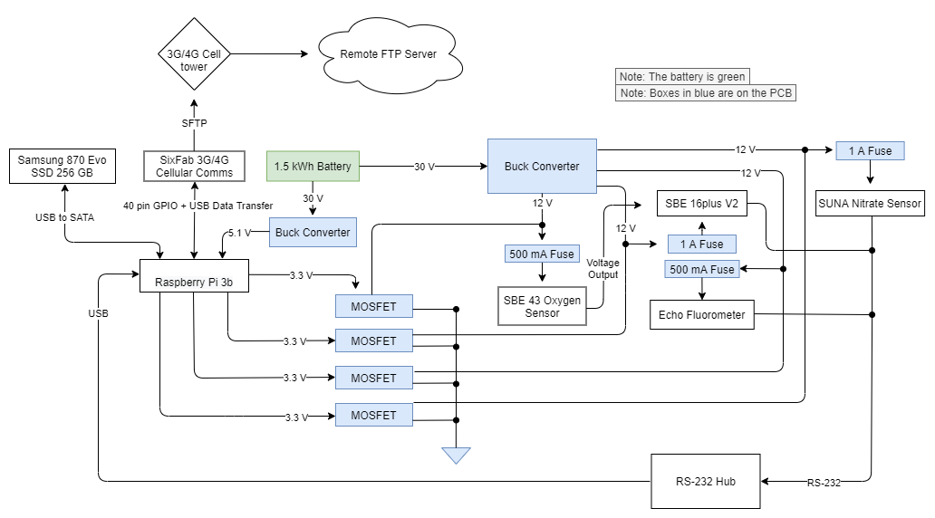

Slide 7
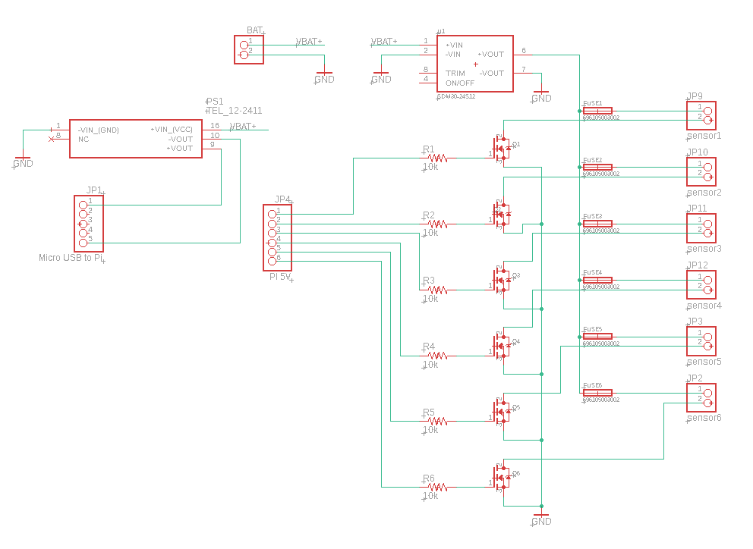

Slide 8
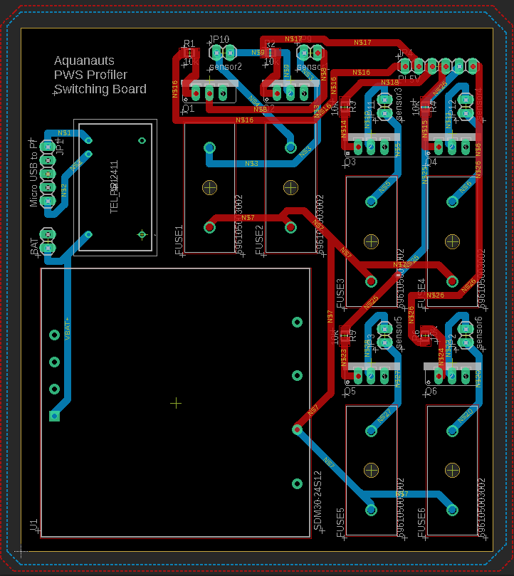
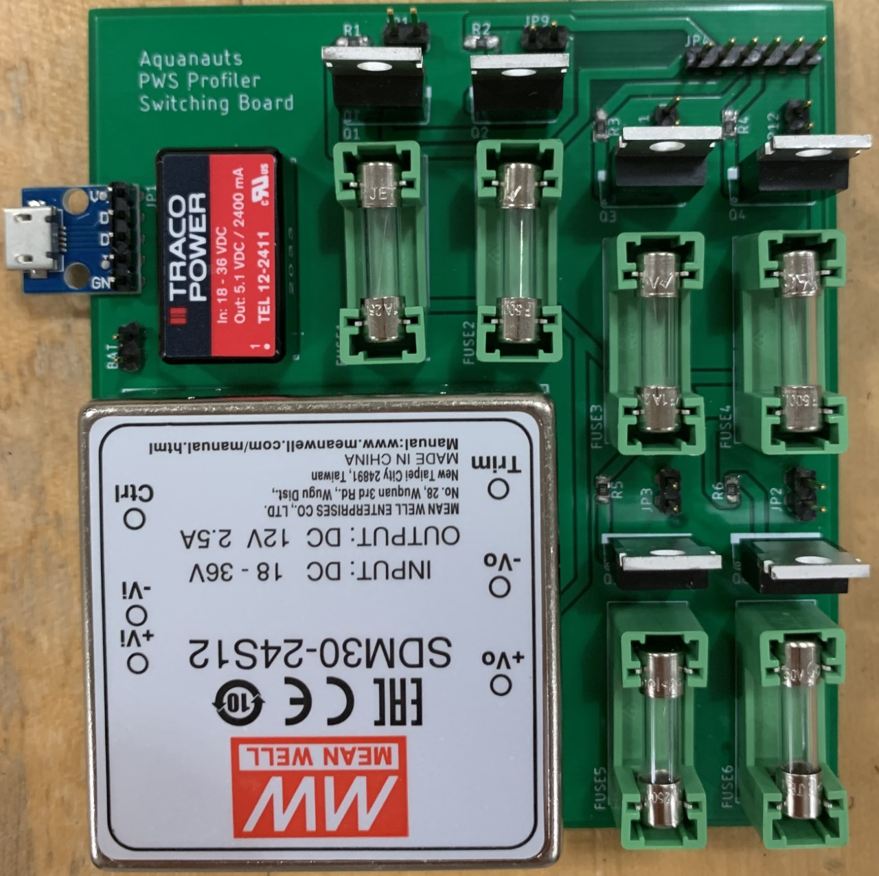
PCB

Slide 9
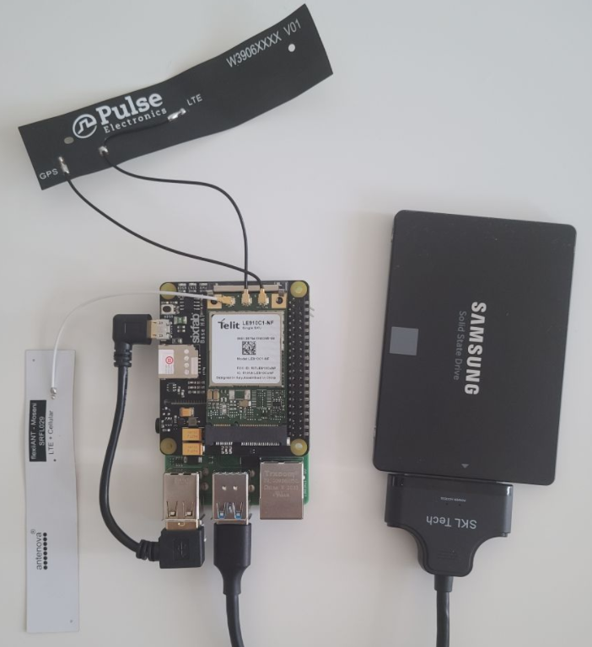
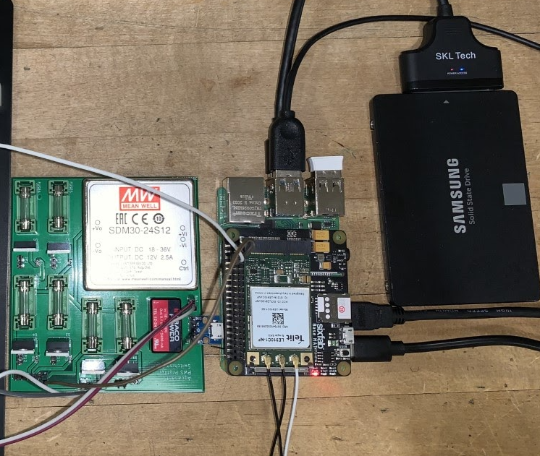
Raspberry Pi and PCB

Slide 10
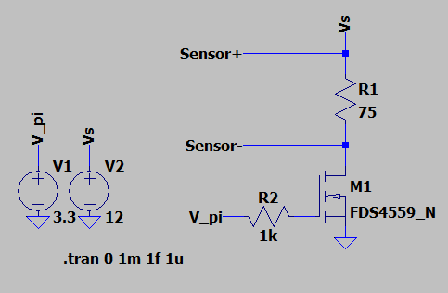
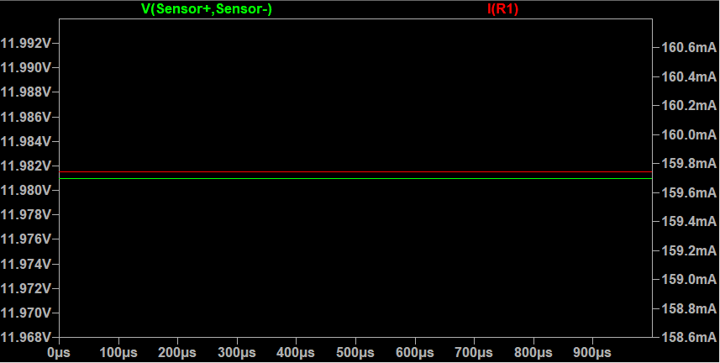
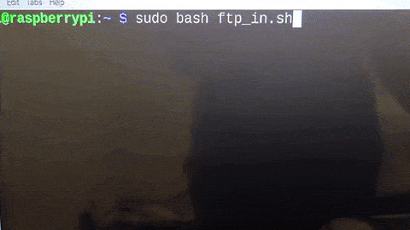
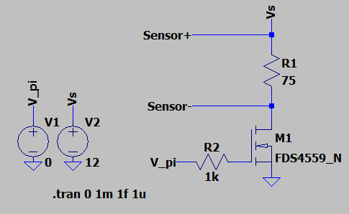
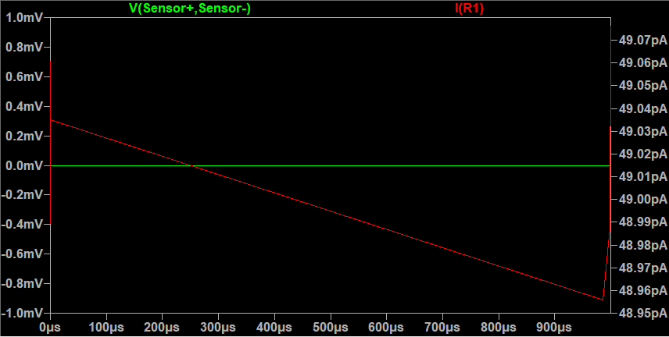
Results (Simulation)

Slide 11
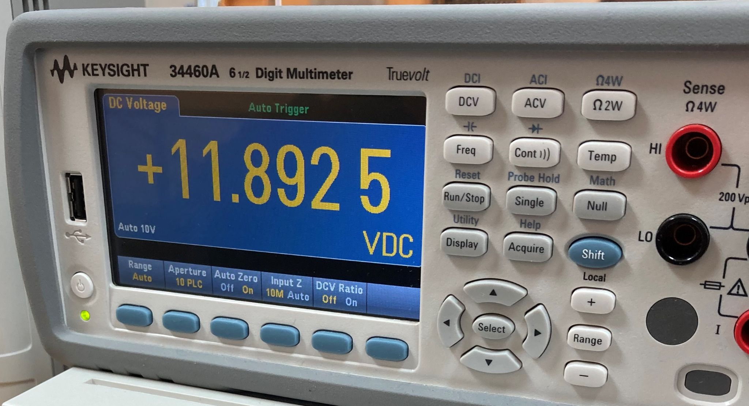
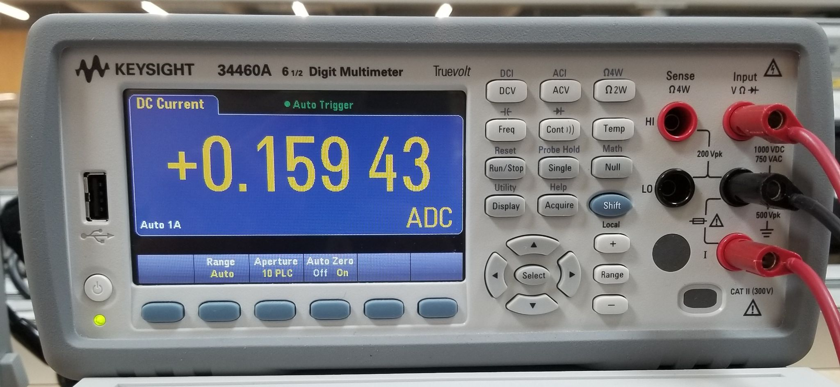
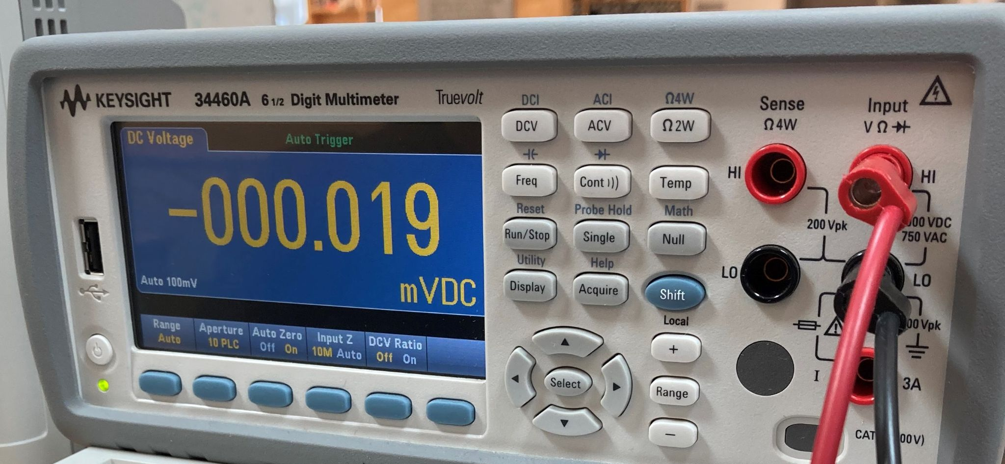
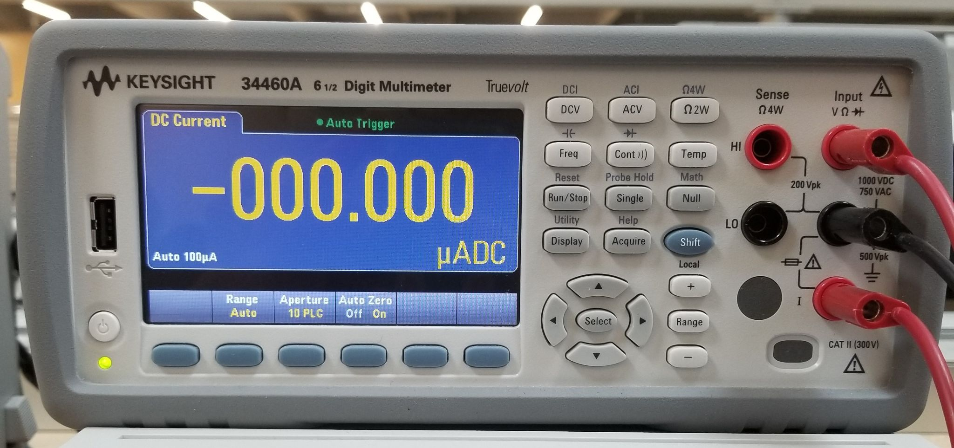
Results (Experimental)

Slide 12
Part | Manufacturer | Retailer | Price per Item | Quantity | Part Total
Raspberry Pi 3B | Raspberry Pi | Amazon | 37.99 | 1 | 37.99
Raspberry Pi 4G/LTE Cellular Modem Kit | Sixfab | Sixfab | 109 | 1 | 109
Sixfab Connect Sim | Sixfab | Sixfab | 2 | 1 | 2
SAMSUNG PRO Plus SDHC Full Size SD Card 32GB | Samsung | Amazon | 9.99 | 1 | 9.99
MKR SD PROTO SHIELD | Arduino | Arduino | 13.8 | 1 | 13.8
USB 3.0 SATA III Hard Drive Adapter Cable, SATA to USB Adapter Cable | SKL Tech | Amazon | 7.99 | 1 | 7.99
SAMSUNG 870 EVO 250GB 2.5 Inch SATA III Internal SSD | Samsung | Amazon | 39.99 | 1 | 39.99
30 W DC/DC Converter | Mean Well USA | Digi-Key | 26.71 | 1 | 26.71
FQP30N06L | ON Semiconductor | Digi-Key | 1.22 | 6 | 7.32
USB to Serial RS232 Adapter | SIIG | Amazon | 49.85 | 1 | 49.85
12 W DC/DC Converter | Traco Power | Digi-Key | 28 | 1 | 28
PCB | JLC PCB | JLC PCB | 14.8 | 1 | 14.8
500 mA Fuse | Bel Fuse Inc | Digi-Key | 0.234 | 5 | 1.17
1A Fuse | Bel Fuse Inc | Digi-Key | 0.224 | 5 | 1.12
5x20 mm Fuse Holder | Würth Elektronik | Digi-Key | 0.64 | 8 | 5.12
Total
354.85

Slide 13




Special thanks to Dr. West and Dr. Campbell

Slide 14
Questions?

